Slide 1

INC300
Week 3
Identity: Deception and Trolling
Amanda Piche, PhD Candidate
June 7th, 2018

Slide 2
Today’s Agenda
Check-in
Lecture: Deception and Trolling

Slide 3
Course Hashtag: #INC300S18
As part of course contributions, students are expected to utilize Twitter to participate in conversations about each week’s material.
Initial tweets, and two replies are due at set times during the week, and students receive points based on quality of engagement.
Your engagement will be measured by several factors: tweeting out to others is the minimum expectation; replying to classmates, engaging with ideas, and connecting external resources is higher level engagement, worthy of more credit.
You are also encouraged to live-tweet during class. Feel free to tweet things from class you found intriguing or questions that you have.

Slide 4
Lecture 3: Deception and Trolling
Learning Outcomes:
Discuss trolls and trolling in a thoughtful manner.
Define key concepts that help explain trolling behaviour, including the theory of the online disinhibition effect, identity tourism, and encoding/decoding of communication.
Describe the difference between “trolling” and “harassment”.

Slide 5
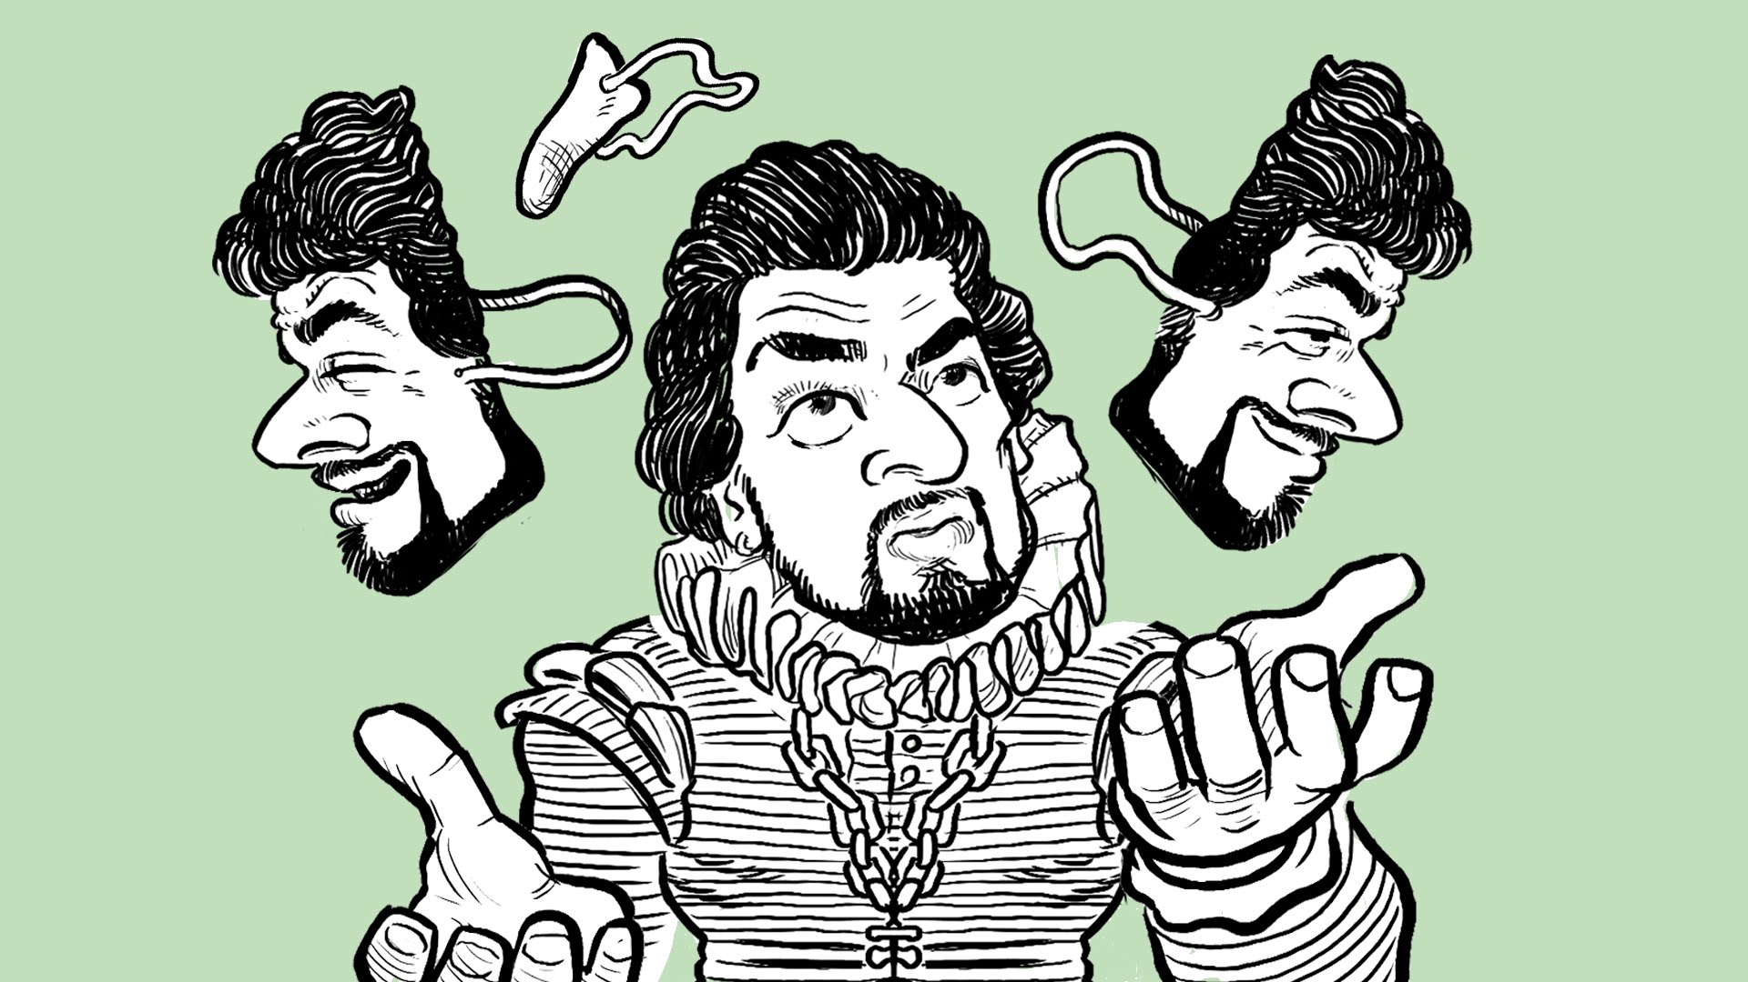

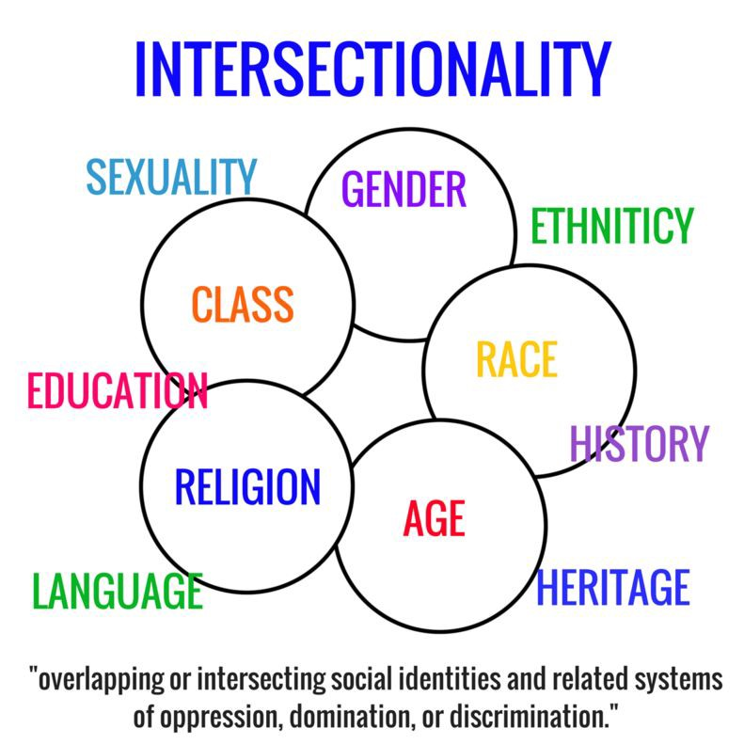
Week 2 Recap
Three theories of identity (dramaturgy, performance, and intersectionality).
How early text-based communications were promised to be a means for Internet users to experiment with new identities, yet with the rise of commercial social networking sites this did not actually come to pass.

Slide 6
QUESTION:
Have you ever lied on the internet? Why or why noy?
Have you ever caught people lying on the internet? What happened?

Slide 7
Everyone lies on the internet (?!)
Michelle Drouin et al, Why do people lie online? “Because everyone lies on the internet” (2016):
  Participants of study reported lying about all kinds of things — their age, their gender, their appearance, activities and interests.
  People were most likely to be honest on social media sites like Facebook. Nearly 32 per cent of people said they were "always honest" on social media.
  People were a little less honest on dating sites and less honest still on anonymous chat sites. People were the least likely to be honest on "sexual communication" websites like Craigslist's casual encounters.
  Between 55 and 90 per cent of participants in the study believed that others were lying at least some of the time about their age, gender, activities, interests and appearance.
  Most people reported lying online in order to make themselves appear better; many lied because they believed the lying was the standard on the internet
  Why care? To become less naïve in our online interactions.
Notes:
Drouin, M., Miller, D., Wehle, S. M., & Hernandez, E. (2016). Why do people lie online? “Because everyone lies on the internet”. Computers in Human Behavior, 64, 134-142.
http://www.cbc.ca/news/technology/misenere-internet-lies-1.3732328

Slide 8
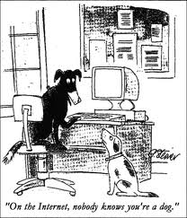
Week 3: Overview
A series of case studies involving identity deception in an online venue
Look at three different examples where the audience was deceived into thinking that the person whose social media they were following was someone different than who they are in reality.
Also be introduced to theoretical frameworks that can be used as a lens to help explain some of the behaviours exhibited in the case studies
Goal of this lecture is to examine some forms of deception you might run into, and provide some theoretical frameworks to better understand why this may happen.
Notes:
Source: Jensen, Klaus Bruhn Social Media and the Struggle for Society. Social Media + Society. 1(1) 1-2.

Slide 9
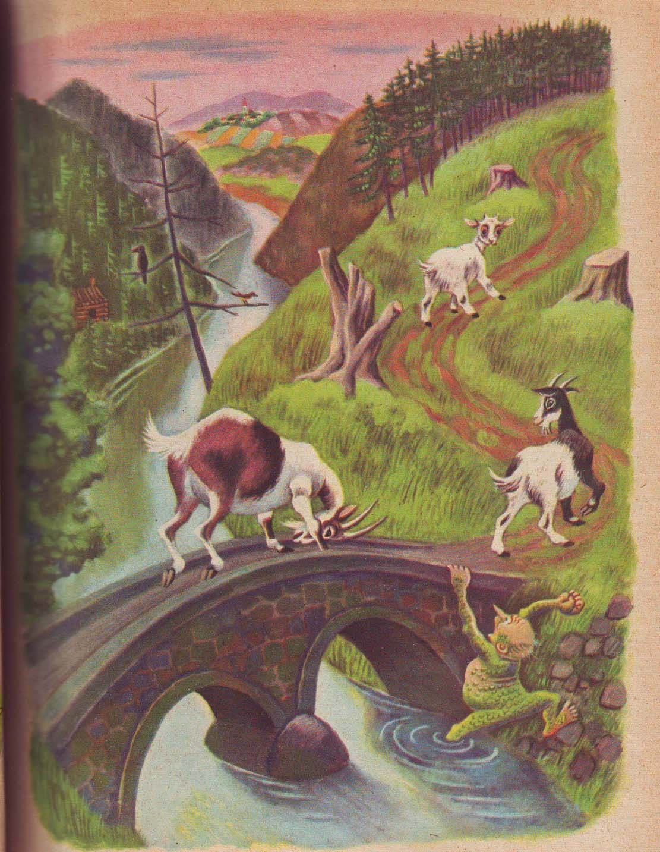
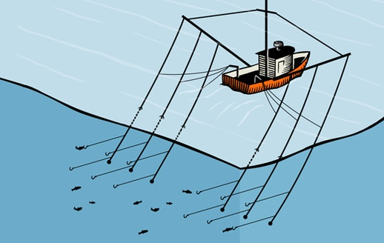
Trolls and Trolling
Trolls are now most often associated with antisocial behaviours displayed via computer-mediated communication, but the term “troll” has a long history that predates the Internet. In particular, there are two very different word origins that are being invoked when the term “troll” or “trolling” is used.
The first is that trolls are creatures from Norse mythology. They are supernatural creatures that are often found in caves or under bridges and are usually not very nice. When this version of the world troll is used, it is typically describing an Internet user who makes things unpleasant for other users, and prevents legitimate conversations from happening in a particular online space.
“Trolling” can also be used in a way that invokes fishing. In this usage of the word, trolling involves stringing lines of bait behind a boat, slowly hooking fish as it travels along in the waters. When this version of troll is used, it is describing an Internet user who is partaking in some sort of identity play, where they “hook” unsuspecting users into lines of conversation that derails any discussion of the actual topic at hand.
Notes:
Hyperlinked in trolling photo: The world's greatest internet troll explains his craft (https://www.youtube.com/watch?v=us4Eti0UmDI)

Slide 10
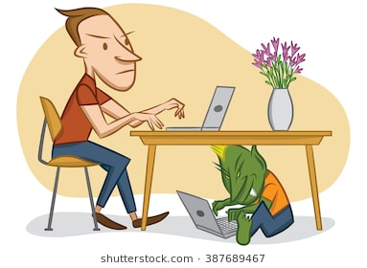
Trolls and Trolling
Whitney Phillips, This is why we can’t have nice things: Mapping the Relationship between Online Trolling and Mainstream Culture (2015)
  Argues that the difference between the Norse mythology and fishing definitions of trolling are an important distinction as one carries a value judgment that the other doesn’t:
  “The speaker’s attitude toward trolls and trolling behaviours often colors his or her understanding of the term’s origins. If he or she sees trolling as mean-spirited and abusive, he or she is more likely to link trolling with the snarling, mythological variety. If he or she is ambivalent or even sympathetic to trolling, his or her account will often make mention of the more value-neutral fishing term” (pg. 15)

Slide 11
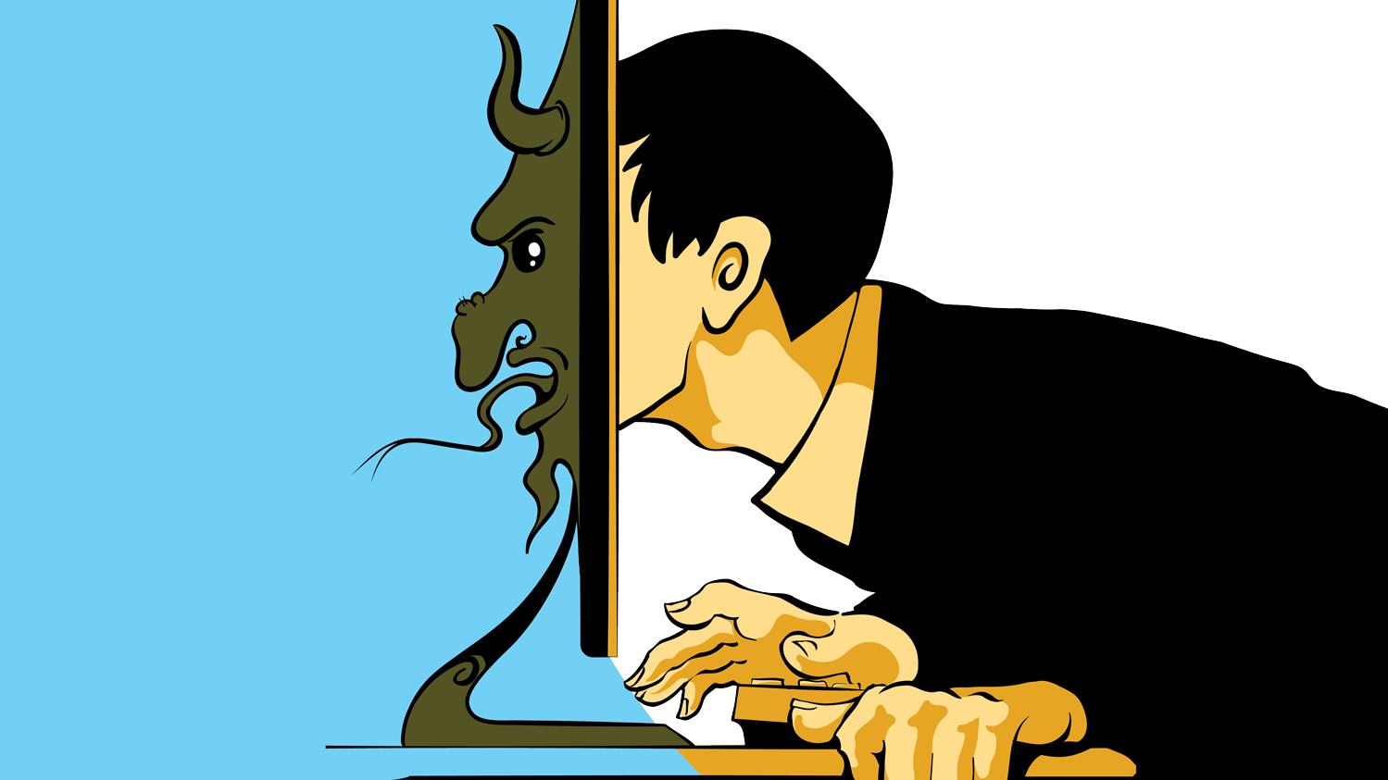
Trolls and Trolling
Judith Donath, “Identity and Deception in the Virtual Community” (1999):
  “Trolling is a game about identity deception, albeit one that is played without the consent of most of the players. The troll attempts to pass as a legitimate participant, sharing the group’s common interests and concerns.” (45)
This can ultimately have an overall negative effect on the quality of conversations in an online community. Too many visits by too many trolls, and a community may begin to become suspicious of all newcomers:
  “A troll can disrupt the discussion on a newsgroup, disseminate bad advice, and damage the feeling of trust in the newsgroup community. Furthermore, in a group that has become sensitized to trolling - where the rate of deception is high - many honestly naïve questions may be quickly rejected as trollings ... Even if the accusation is unfounded, being branded a troll is quite damaging to one’s online reputation.” (45)
Instead of creating an authentic online identity, trolls actively work to convince their audience they are something they are not.
Because we can never be completely sure who we are dealing with online there is always the possibility that someone whose identity that you have not yet verified in a face-to-face encounter could be engaging in some sort of trolling behaviour.
Notes:
Donnath, Judith (1999). Identity and Deception in the virtual community. In Smith, M. A., & Kollock, P. (1999). Communities in cyberspace. (pp. 29-59). New York, NY: Routledge.

Slide 12
Trolling vs. Harassment
While the definitions we just covered are widely accepted and utilized in an academic context, this is not necessarily the case for more mainstream discussions.
In recent years as Internet usage has increased, coverage of sensational events that happen partly or fully online have begun to be covered by news outlets. In this coverage, the term “troll” is often used to describe a wide range of online behaviour such as racist, sexist, or homophobic speech - a far cry from the previous definition of identity deception.
By conflating hate speech, harassment, bullying, etc. with trolling, it actually minimizes the harm such words can cause by making it seem like it is done by an anonymous, chaotic force:
  “Ultimately, however, the biggest problem with the vague catch-all term “troll” is that it imposes an artificial boundary between so-called trolls (whatever that even means) and “regular” Internet users. This makes it seem as if the only people engaging in nasty behaviour is this one, apparently unified group of malcontents-and that is simply false. Nasty behaviour online can come from anyone: your neighbour, your kids’ high school classmates, your colleague at work, yourself in a bad mood.“ (Phillips, 2013a)
Notes:
Phillips, Whitney. (2013a, May 20). A Brief History of Trolls. The Daily Dot. Available: http://www.dailydot.com/via/phillips-brief-history-of-trolls/

Slide 13
Forms of Cyberbullying
Types of cyberbullying
  Harassment - Repeatedly sending offensive, rude, and insulting messages.
  Denigration - Distributing information about someone else that is derogatory and untrue by posting it on a webpage, sending it through email or instant messaging, or posting or sending digitally altered photos of someone.
  Flaming - Online fighting using electronic messages with angry, vulgar language.
  Impersonation - Breaking into an email or social networking account and using that person's online identity to send or post vicious or embarrassing material to/about others.
  Outing and Trickery - Sharing someone's secrets or embarrassing information, or tricking someone into revealing secrets or embarrassing information and forwarding it to others.
  Cyber Stalking - Repeatedly sending messages that include threats of harm or are highly intimidating, or engaging in other online activities that make a person afraid for his or her safety (depending on the content of the message, it may be illegal).

Slide 14
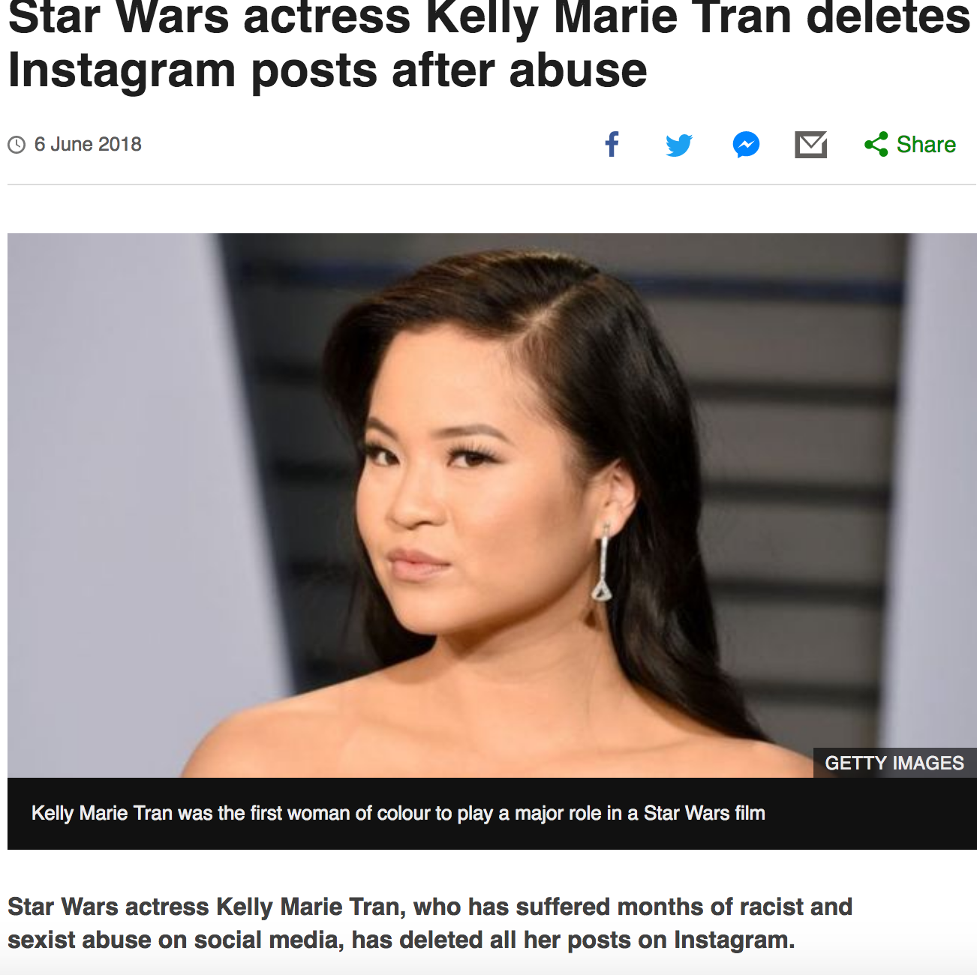
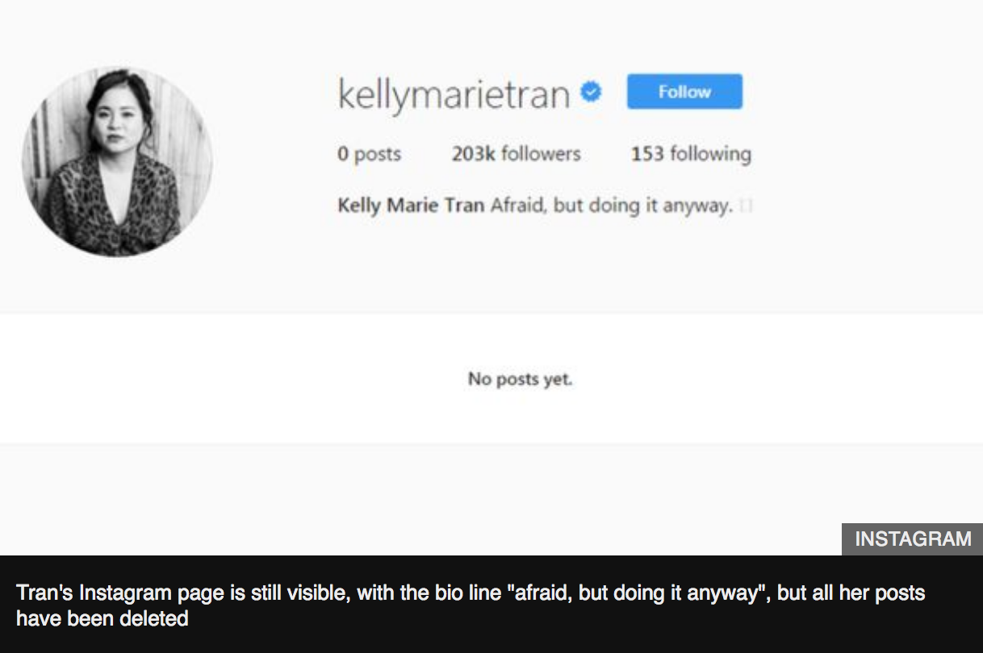

Slide 15
Why the Online Trolls Troll
According to Jesse Fox, PhD, research in communication and psychology help explain why online trolls troll:
  Anonymity → online disinhibition effect (anonymity drives deviant behaviour)
  Perceived obscurity → trolls believing their expressions are still relatively private
  Perceived majority status → spiral of silence theory (when people think they are in the majority in a setting, they will more freely express their opinion than those who feel they are in the minority)
  Social identity salience → social identity model of deindividuation effects (online, social identity sometimes mean more than individual identity; “mob mentality”)
  Surrounded by “friends” → assume others in social network are just like you
  Desensitization → desensitized to online environment; lose our filter; easier to type something offensive into a screen
  Personality traits → some outspoken, morally superior, like to make others angry
  Perceived lack of consequences → social exchange theory (analyze costs and benefits in communication; expressing yourself has more benefits than costs)
Notes:
https://www.psychologytoday.com/us/blog/better-living-technology/201408/why-the-online-trolls-troll

Slide 16
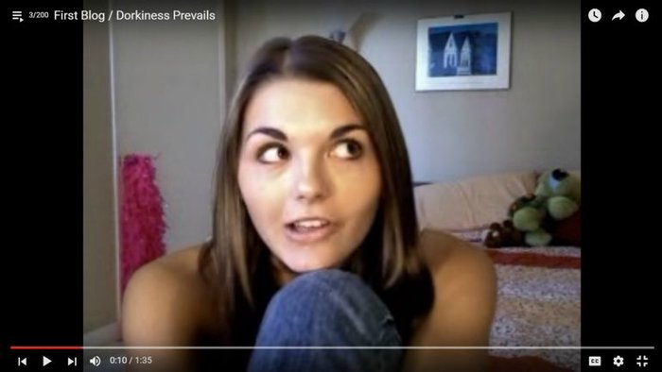
Case Study 1: Lonelygirl15

Slide 17
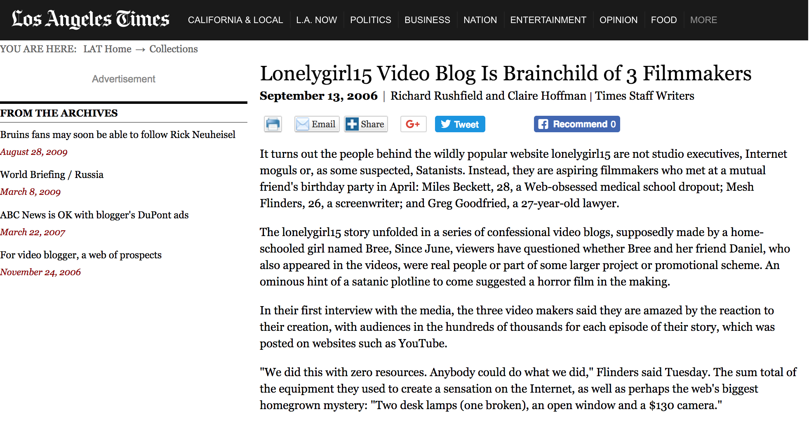
Case Study 1: Lonelygirl15

Slide 18

The Online Disinhibition Effect
One possible reason for why some Internet users engage in deception is the online disinhibition effect
The online disinhibition effect suggests that online anonymity may drive more deviant behavior, because it is easy to avoid consequences
Notes:
Hyperlink in the photo that explains online disinhibition effect: https://academicearth.org/electives/psychology-internet-troll/

Slide 19
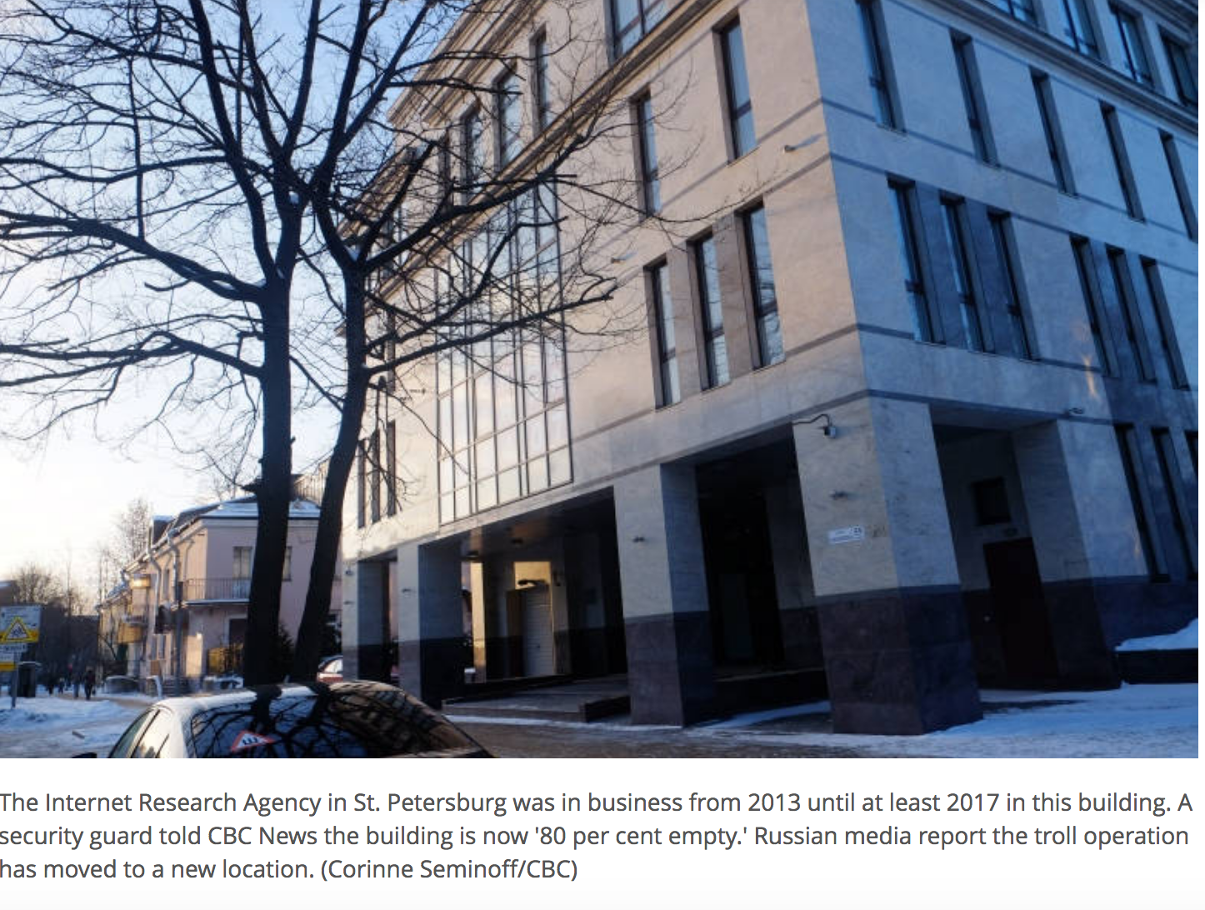
The Construction of Fake News
Fake news: a type of yellow journalism or propaganda that consists of deliberate misinformation or hoaxes spread via traditional print and broadcast news media or online social media
Written and published with the intent to mislead in order to damage an agency, entity, or person, and/or gain financially or politically → often by employees in ‘troll factories’
Notes:
http://www.cbc.ca/news/world/russia-trolls-internet-fake-news-1.4562526

Slide 20

Trolling and the Spread of Misinformation
“April 3, 2018: Police responded to an active shooter at YouTube headquarters in San Bruno, California that left three people injured and one dead. But before police could even get a grasp on the situation, Twitter erupted with lies and misinformation.”
“While many people on Twitter grabbed their "fake news" pitchforks, this situation felt different than the misinformation spread in the past, especially during the election. This wasn't some politically-driven website promoting lies; this was straight up trolling in the most classic sense of the word.” – Mashable.com
Notes:
https://mashable.com/2018/04/03/youtube-shooting-trolling-fake-news/#Eoaw0MrRvuqm

Slide 21
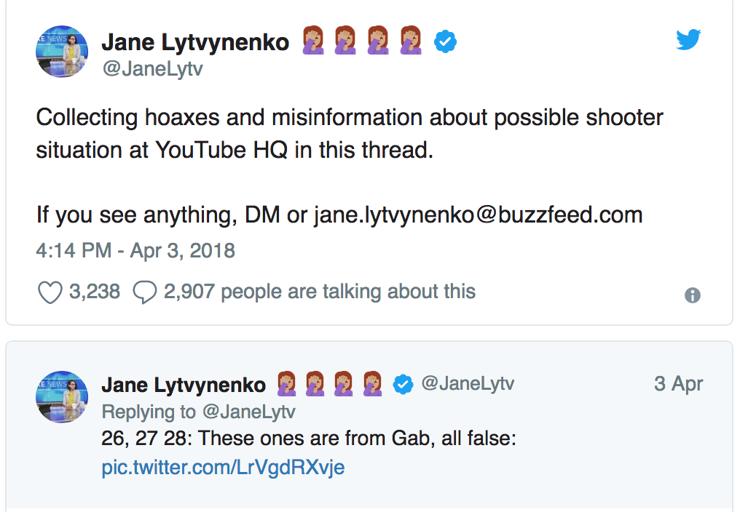
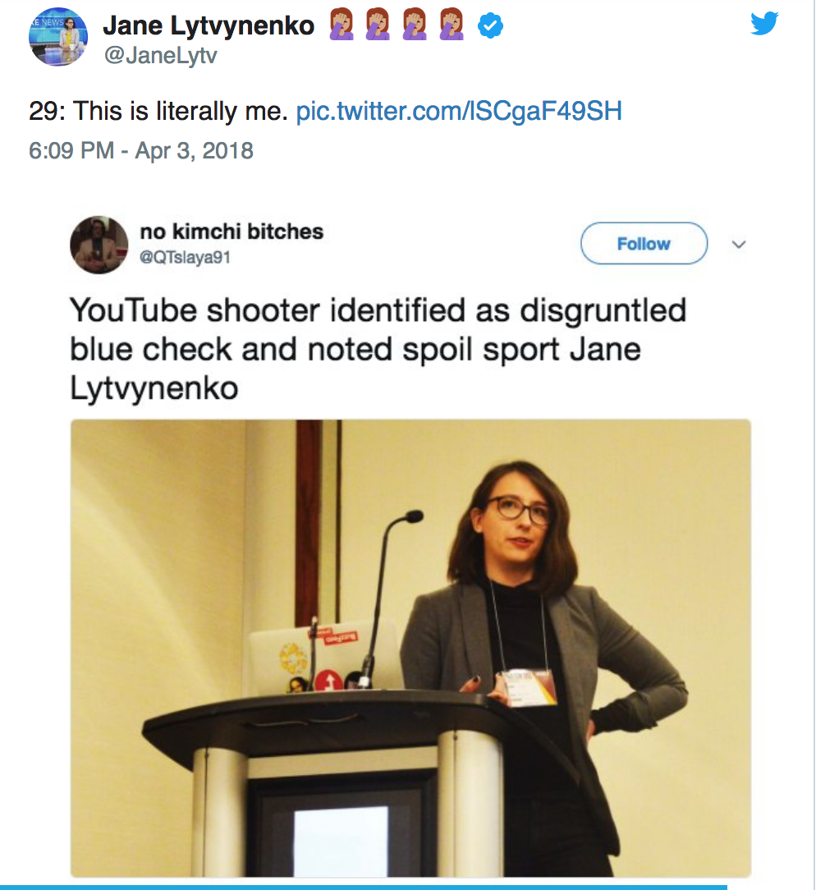

Slide 22
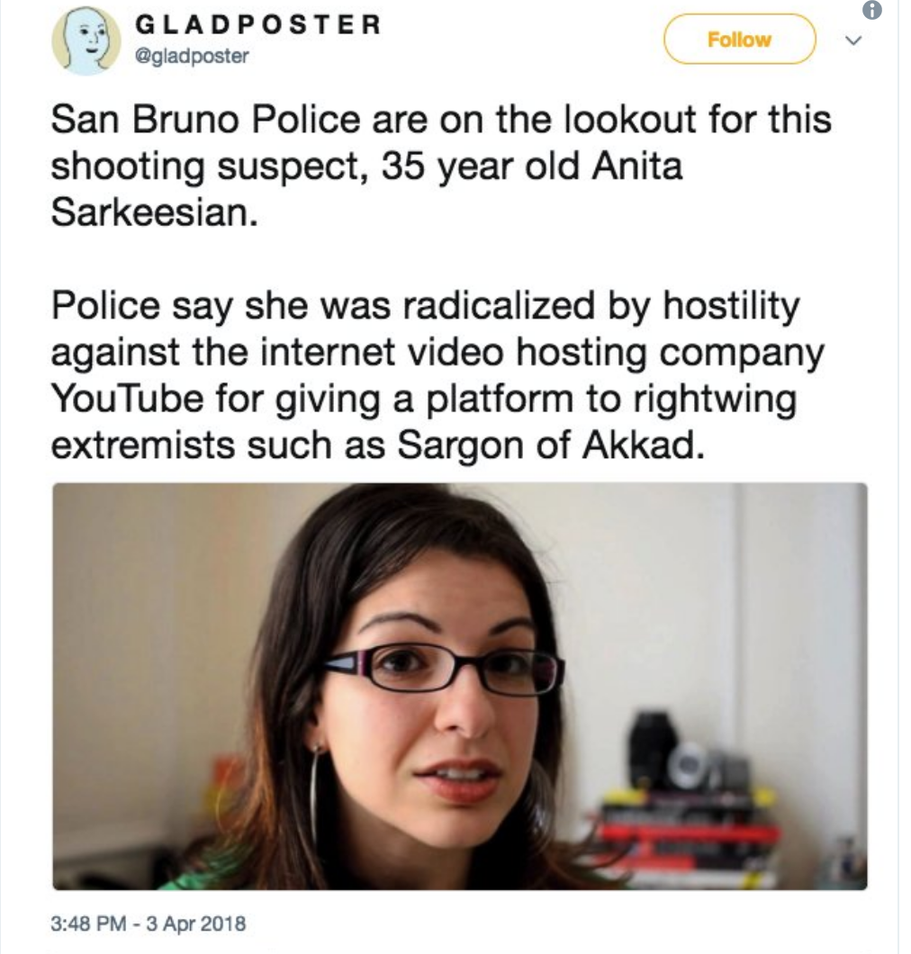
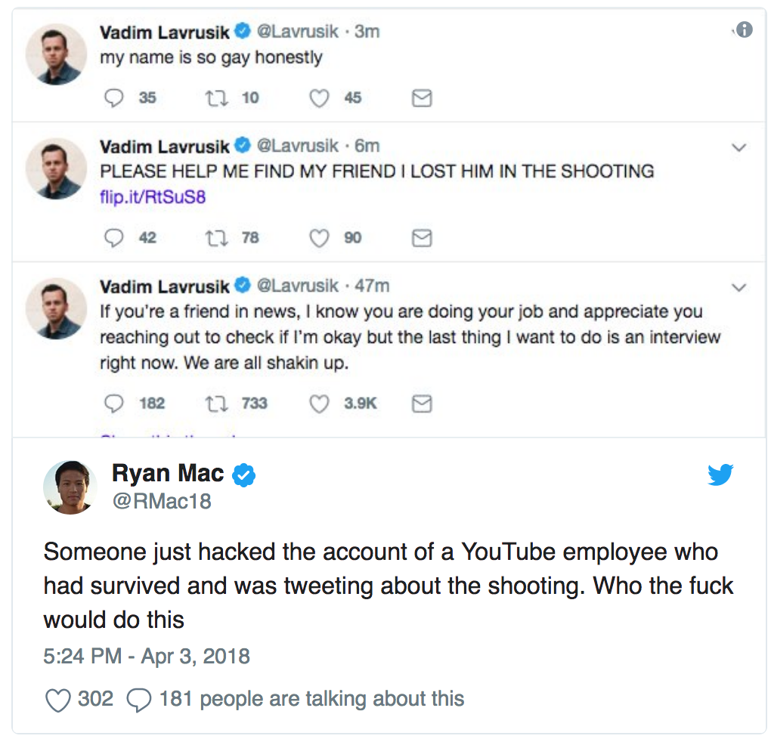
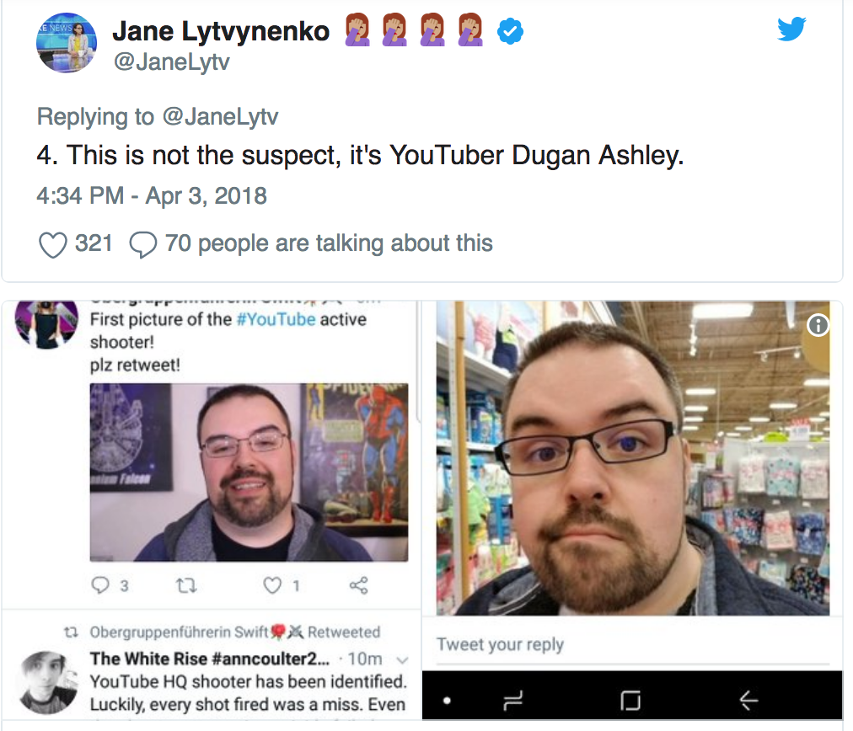
Notes:
Before any information about the shooter was released, one Twitter account which has since been suspended, falsely claimed the shooter was Anita Sarkeesian, a GamerGate victim.

Slide 23
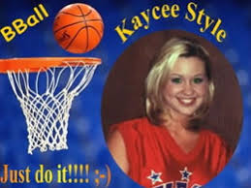
Case Study 2: Kaycee Nicole Swenson
Kaycee Nicole Swenson was most notable for her blog, which ran from 1999 to 2001. Updated almost daily for two and a half years, she wrote about her life as a teenager and her battle with Leukemia. Occasionally her mother, Debbie, would post to the blog on days her daughter was too ill to sit in front of the computer
Shortly after the announcement of the teen’s death was posted to the blog, members of her community of supporters began to question the veracity of Debbie’s description of her daughter’s life and death.
Soon enough, the whole story began to unravel and enough proof was gathered to confirm that Kaycee never existed and Debbie had been the one orchestrating it all.
''The whole idea of an online journal is to write what you want to write,'' [Debbie Swensen] said. ''I wanted it to be something positive.''
Notes:
https://www.nytimes.com/2001/05/31/technology/a-beautiful-life-an-early-death-a-fraud-exposed.html

Slide 24
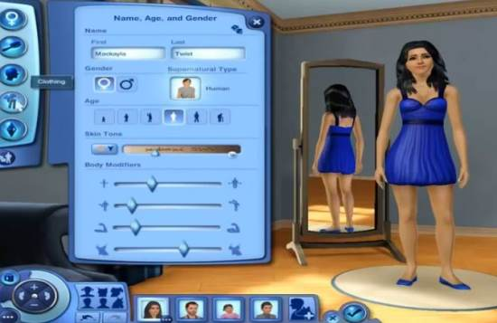
Identity Tourism
In her chapter exploring how users played with race when creating new identities for themselves in a text-based MOO, Lisa Nakamura found that users indicating in their bio that they were taking on the role of an Asian character overwhelmingly focused on stereotypical depictions of an Oriental warrior drawing heavily on popular culture e.g. film or video games. Nakamura uses the metaphors of tourism to emphasize these identities were temporary, recreational, and exotic.
Notes:
Nakamura, Lisa. (2000). “Race in/for Cyberspace: Identity Tourism and Racial Passing on the Interent”. In Bell, David and Kennedy Barbara M. (eds), The Cybercultures Reader. (pp 712-720). London, UK: Routledge.

Slide 25
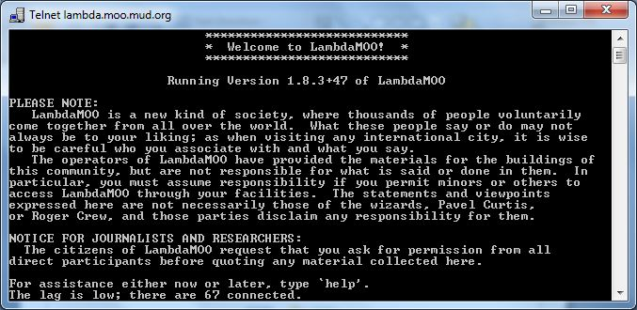
Identity Tourism
“The choice to enact oneself as a samurai warrior in LambdaMoo constitutes a form of identity tourism which allows a player to appropriate an Asian racial identity without any of the risk associated with being a racial minority in real life. While this might seem to offer a promising venue for non-Asians characters to see through the eyes of the Other by performing themselves as Asian through on-line textual interaction, the fact that the personae chosen are overwhelmingly Asian stereotypes blocks this possibility by reinforcing these stereotypes.” (Nakamura, 2000, 714)
Notes:
Nakamura, Lisa. (2000). “Race in/for Cyberspace: Identity Tourism and Racial Passing on the Interent”. In Bell, David and Kennedy Barbara M. (eds), The Cybercultures Reader. (pp 712-720). London, UK: Routledge.

Slide 26
Identity Tourism
“The choice to enact oneself as a samurai warrior in LambdaMoo constitutes a form of identity tourism which allows a player to appropriate an Asian racial identity without any of the risk associated with being a racial minority in real life. While this might seem to offer a promising venue for non-Asians characters to see through the eyes of the Other by performing themselves as Asian through on-line textual interaction, the fact that the personae chosen are overwhelmingly Asian stereotypes blocks this possibility by reinforcing these stereotypes.” (Nakamura, 2000, 714)
Notes:
Nakamura, Lisa. (2000). “Race in/for Cyberspace: Identity Tourism and Racial Passing on the Interent”. In Bell, David and Kennedy Barbara M. (eds), The Cybercultures Reader. (pp 712-720). London, UK: Routledge.

Slide 27
Identity Tourism
This sort of behaviour has become to be known as identity tourism. We can make connections to Goffman’s descriptions of masks and identity cues, but in this case these identity cues are being used to make the audience think that the speaker is someone they are not.
In this case, Nakamura is describing how Internet users can construct a new identity online and pretend to be someone they are not, but not actually ever be on the receiving end of any discrimination that a person with this actual lived experience would experience.
Perhaps Debbie wanted to experience being the center of attention and therefore took on the role of Kaycee. Debbie was able to have a group of fans who supported her, without having to go through the actual pain and suffering of losing a loved one to cancer.
Notes:
Nakamura, Lisa. (2000). “Race in/for Cyberspace: Identity Tourism and Racial Passing on the Interent”. In Bell, David and Kennedy Barbara M. (eds), The Cybercultures Reader. (pp 712-720). London, UK: Routledge.

Slide 28
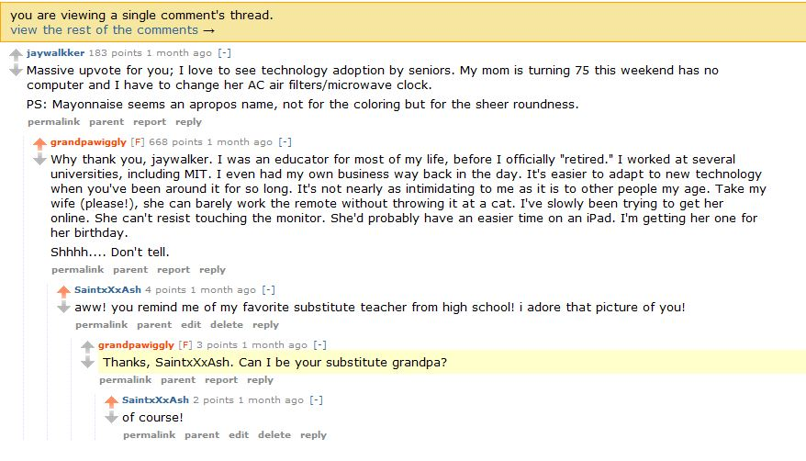
Case Study 3: Grandpa Wiggly

Slide 29
Case Study 3: Grandpa Wiggly
Controversy arose when it was discovered that Grandpa Wiggly was not actually an old man. Instead, he was a character being played by another active user of the site who went by the name Wordsauce.
Adding extra confusion to this situation is that Wordsauce never intended to deceive the community, he thought that other members of the Reddit community were in on the joke. He explains:
“Grandpa Wiggly is a character, I thought more people understood that. That was my mistake. It seems to be spilt down the middle. For every “I hope you die” message I’ve received, I’ve received encouraging messages from the people who were playing along the whole time and who knew it was a novelty. All I was trying to do was tell a story, to entertain, it’s all I’ve ever wanted to do. It was interactive fiction, plain and simple, kind of like a choose-your-own-adventure. There was no sinister motive behind all of this. I had no end game. I would love nothing more than to continue the character of Grandpa Wiggly but I don’t think that’s possible on Reddit. I will still maintain Grandpa Wiggly’s blog as there is much story still to be told.” (Wordsauce as quoted in Bergstrom, 2011)
Notes:
Bergstrom, Kelly. (2011). “Don’t feed the troll”: Shutting down debate about community expectations on Reddit.com. First Monday, 16(8). doi:10.5210/fm.v16i8.3498

Slide 30
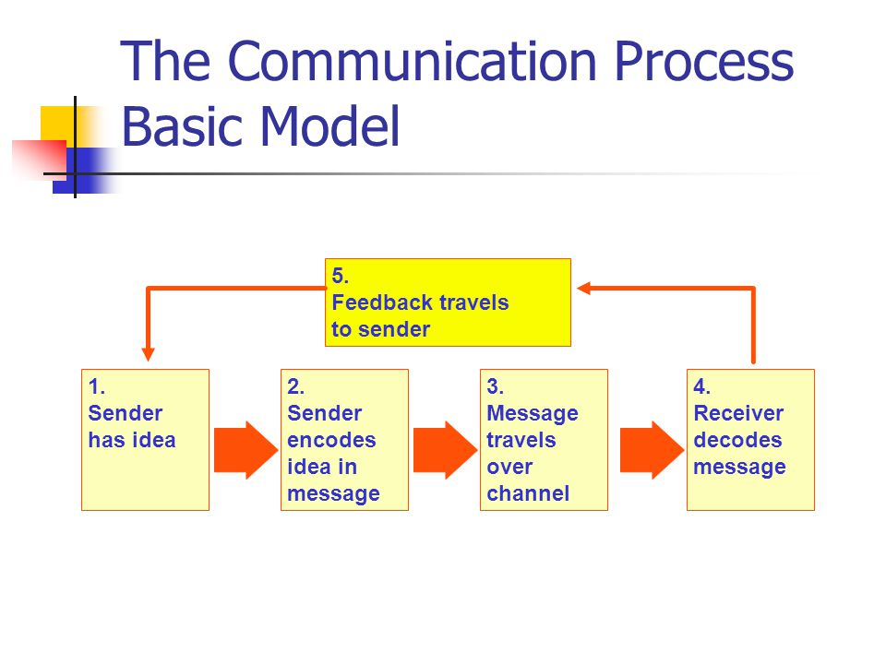
Encoding/Decoding Model of Communication
Theory of communication that was developed by Stuart Hall
Hall wanted to create a theory of communication that accounted for the fact that how you interpret a message is culturally dependent
According to the encoding/decoding model of communication, your reception and interpretation of a message will be the result of both the content of the message, but also your social identity.

Slide 31
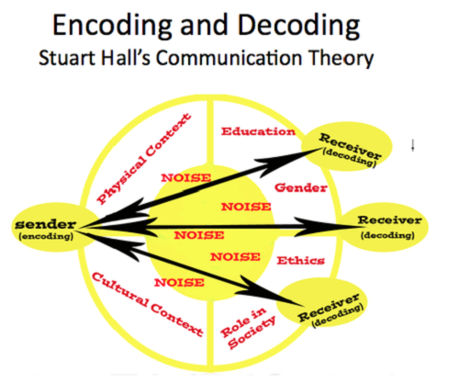
Encoding/Decoding Model of Communication
Hall theorized that when receiving a message, one of three interpretations happen:
1) The audience member received the intended message. They understand the message intended by its creator. This is known as the dominant or preferred reading.
2) The audience member understands the message and broadly accepts the intended message, but modifies it in a way that reflects their own experiences. This is known as the negotiated reading.
3) The audience member understands the intended message, but does not agree with it or even rejects it. This is known as the oppositional reading.

Slide 32
Encoding/Decoding Model of Communication
The model is broad enough that it can be used in multiple circumstances, not just television, as was intended. In the case of Grandpa Wiggly, we see a disconnect between what Wordsauce intended (that Grandpa Wiggly was understood as being a fictional character and other Reddtors were “in on the joke”) and how it was decoded by other members of the Reddit community.
The larger lesson here is that when communicating on social media, your audience may not always understand the intended meaning of your message. Some of your readers may interpret your message in a way that you did not intend or in some cases outright reject it.

Slide 33
Activity
In groups of two or three, discuss the following:
What would you do about trolling comments if you were in charge of a social media site? Come up with a strategy for how you will respond. Would you remove comments? Moderate the site carefully? Let anyone post at will? Another strategy?

Slide 34
Bringing the Threads Together
Have been introduced to case studies and theoretical frameworks that can be used to make sense of them. These theoretical frameworks may also be helpful for you to unpack other events, should you encounter online deception in the future.
These three case studies also serve as examples of what might be called “trolling” when reported on by the mainstream media. However, as discussed earlier in this lecture, the term troll has become so widely used that it is beginning to lose its meaning.
We are often given the advice “don’t feed the troll”, as people engaging in trolling behaviours are likely doing it for attention. This is something that Ken M described in the video you watched earlier in this lecture, if it were not for the audience and positive feedback he received for playing this particular role online, he would have moved on to a different hobby by now.
However, if you find yourself on the receiving end of harassment simply ignoring it may not be the best course of action.
If messages have crossed the line into hate speech or if your personal information is being posted online (“doxxing”), it is important to reach out to an authority (e.g. the police, school administrators, HR) to get help.

Slide 35
Lecture 3: Identity: Deception and Trolling Summary
In this lesson, we have:
Defined trolls and trolling, and explored the difference between trolling and harassment.
Looked at several case studies where deception was discovered in an online venue.
Explored theoretical frameworks that can be used to help understand these case studies.

Slide 36
For next week:
Next week’s class (June 14th) will be in-class!
Lecture material will be made available online and must be read before class
Ensure you post one tweet and two replies on Twitter before our next meeting
Note! First test, June 28th (in-class)

